Slide 1
Maruti Suzuki Site
Prepared by: Anshika Srivastava
2121002

Slide 2
Overview of Project
HTML Code:
<!DOCTYPE html>
<html>
<head>
<title>Maruti suzuki</title>
<link rel="stylesheet" type="text/css" href="project.css">
</head>
<body>
<center>
<marquee id="marquee"><img src="maruti-logo.png"></marquee>
<h1>Hatchbacks collection</h1>
<table>
<form>
<tr>
<td><img src="swift.png" name="sw"></td>
<td><img src="CelerioX.png" name="cx"></td>
<td><img src="Celerio.png" name="ce"></td>

Slide 3
</tr>
<tr>
<th>Swift</th>
<th>CelerioX</th>
<th>Celerio</th>
</tr>
<tr>
<td align="center"><dfn title="Pearl Metallic Midnight Blue"><button id="b1">.</button></dfn>
<dfn title="Pearl Metallic Lucent Orange"><button id="b2">.</button></dfn>
<dfn title="Solid Fire Red"><button id="bu2">.</button></dfn>
</td>
<td align="center"><dfn title="Glistening Grey"><button id="bu1">.</button></dfn>
<dfn title="Paprika Orange"><button id="b2">.</button></dfn>
<dfn title="Arctic White"><button id="b3">.</button></dfn>
</td>
<td align="center"><dfn title="Torque Blue"><button id="b1">.</button></dfn>
<dfn title="Blazing Red"><button id="bu2">.</button></dfn>
<dfn title="Arctic White"><button id="b3">.</button></dfn>
</td>

Slide 4
</tr>
<tr>
<td>
<table align="center">
<tr>
<th id="Length">Length</th>
<th id="Width">Width</th>
<th>Height</th>
</tr>
<tr>
<td>3840 mm</td>
<td>1735 mm</td>
<td>1530 mm</td>
</tr>
</table>
</td>
<td>
<table align="center">
<tr>

Slide 5
<th id="Length">Length</th>
<th id="Width">Width</th>
<th>Height</th>
</tr>
<tr>
<td>3715 mm</td>
<td>1635 mm</td>
<td>1565 mm</td>
</tr>
</table>
</td>
<td>
<table align="center">
<tr>
<th id="Length">Length</th>
<th id="Width">Width</th>
<th>Height</th>
</tr>
<tr>

Slide 6
<td>3695 mm</td>
<td>1600 mm</td>
<td>1560 mm</td>
</tr>
</table>
</td>
</tr>
<tr>
<th>Capacity</th>
<th>Capacity</th>
<th>Capacity</th>
</tr>
<tr>
<td align="center">1197 cc</td>
<td align="center">998 cc</td>
<td align="center">998 cc</td>
</tr>
<tr>
<th>Transmission Type</th>
<th>Transmission Type</th>
<th>Transmission Type</th>
</tr>

Slide 7
<tr>
<td align="center">5MT</td>
<td align="center">5MT</td>
<td align="center">5MT</td>
</tr>
<tr>
<td>
<table align="center">
<tr>
<th rowspan="2">Brakes:</th>
<th id="Length">Front</th>
<th>Rear</th>
</tr>
<tr>
<td>Disc</td>
<td>Drum</td>
</tr>
</table>
</td>
<td>
<table align="center">
<tr>

Slide 8
<th rowspan="2">Brakes:</th>
<th id="Length">Front</th>
<th>Rear</th>
</tr>
<tr>
<td>Ventilated Disc</td>
<td align="right">Drum</td>
</tr>
</table>
</td>
<td>
<table align="center">
<tr>
<th rowspan="2">Brakes:</th>
<th id="Length">Front</th>
<th>Rear</th>
</tr>
<tr>
<td>Ventilated Disc</td>
<td align="right">Drum</td>
</tr>
</table>

Slide 9
</td>
</tr>
<tr>
<td>
<table align="center">
<tr>
<th rowspan="2">Suspension:</th>
<th id="Length">Front</th>
<th>Rear</th>
</tr>
<tr>
<td>Mac Pherson Strut</td>
<td align="right">Torsion Beam</td>
</tr>
</table>
</td>
<td>
<table align="center">
<tr>
<th rowspan="2">Suspension:</th>
<th id="Length">Front</th>
<th>Rear</th>

Slide 10
</tr>
<tr>
<td>MacPherson strut with coil spring</td>
<td align="right">Coupled torsion beam axle with coil spring</td>
</tr>
</table>
</td>
<td>
<table align="center">
<tr>
<th rowspan="2">Suspension:</th>
<th id="Length">Front</th>
<th>Rear</th>
</tr>
<tr>
<td>MacPherson strut with coil spring</td>
<td align="right">Coupled torsion beam axle with coil spring</td>
</tr>
</table>

Slide 11
</td>
</tr>
<tr>
<th>Seating Capacity</th>
<th>Seating Capacity</th>
<th>Seating Capacity</th>
</tr>
<tr>
<td align="center">5 Persons</td>
<td align="center">5 Persons</td>
<td align="center">5 Persons</td>
</tr>
<tr>
<th>Fuel Tank Capacity</th>
<th>Fuel Tank Capacity</th>
<th>Fuel Tank Capacity</th>
</tr>
<tr>
<td align="center">37 L</td>
<td align="center">35 L</td>
<td align="center">35 L</td>
</tr>

Slide 12
</form>
</table>
<h2 id="si">Swift Interior & Exterior</h2>
<div class="slider">
<div class="img-box">
<img src="img1/a1.png" align="center" class="slider-img1">
</div>
<button class="btn" onclick="prev1()">&lt;</button><button class="btn" onclick="next1()">&gt;</button>
</div>
<h2 id="si">Celerio Interior & Exterior</h2>
<div class="slider">
<div class="img-box">
<img src="img2/b1.jpg" align="center" class="slider-img2">
</div>
<button class="btn" onclick="prev2()">&lt;</button><button class="btn" onclick="next2()">&gt;</button>

Slide 13
</div>
<h2 id="si">Celerio X Interior & Exterior</h2>
<div class="slider">
<div class="img-box">
<img src="img3/c1.jpg" align="center" class="slider-img3">
</div>
<button class="btn" onclick="prev3()">&lt;</button><button class="btn" onclick="next3()">&gt;</button>
</div>
<script src="project.js"></script>
<p>
Contact us by:-<br>
Mobile No.-522-000-123<br>
Email-maruti@yahoo.com<br>
Address-C/1 Vikas Nagar,<br>
near Sewa Hospital,<br>
New Delhi,India<br>
Pincode-229019<br>

Slide 14
Thank You !!!!
</p>
</center>
</body>
</html>

Slide 15
CSS Code
th{font-size: 30px;}
#b1{background-color: rgb(9,20,60);}
#b2{background-color: rgb(218,104,15);}
#b3{background-color: rgb(255,255,255);}
#bu1{background-color: rgb(177,178,190);}
#bu2{background-color: rgb(255,0,0);}
#Length{border-right-width: 2px;border-right-style: solid;}
#Width{border-right-width: 2px;border-right-style: solid;}
h1{font-family: Castellar;text-decoration: underline;border-left-color: rgb(17,30,108);border-top-color: rgb(17,30,108);
border-style: dotted;border-bottom-color: white;border-right-color: white;border-width: 10px;}
body{background-color: grey}
#img1{scroll-behavior: smooth;}
td{font-size: 20px;}
#marquee{direction: left;}
.slider1{width:50%;margin: 50px auto;}
.btn{border:none;outline: none;background: black;padding: 10px 30px;color: white;margin: 10px auto;}

Slide 16
.btn:hover{background: red;}
#si{border-color: black;border-width: 5px;border-style: double;}
p{background: black;color: white;font-size: 35px;}
input{width: 120px;height: 45px;font-size: 20px;}

Slide 17
JAVASCRIPT Code
var slider_img = document.querySelector('.slider-img1');
var images = ['a1.png','a2.png','a3.png','a4.png','a5.png','a6.jpg','a7.jpg','a8.jpg','a9.jpg','a10.jpg'];
var i = 0;
function prev1() {
if (i <= 0) {
i = images.length;
}
i--;
return setImage1();
}
function next1(){
if (i >= images.length-1) {
i = -1;
}
i++;

Slide 18
return setImage1();
}
function setImage1(){
return slider_img.setAttribute('src','img1/' + images[i]);
}
var slider_img1 = document.querySelector('.slider-img2');
var images1 = ['b1.jpg','b2.jpg','b3.jpg','b4.jpg','b5.jpg','b6.jpg','b7.jpg','b8.jpg','b9.jpg','b10.jpg'];
function prev2() {
if (i <= 0) {
i = images1.length;
}
i--;
return setImage2();
}
function next2() {
if (i >= images1.length-1) {
i = -1;

Slide 19
}
i++;
return setImage2();
}
function setImage2() {
return slider_img1.setAttribute('src','img2/' + images1[i]);
}
var slider_img2 = document.querySelector('.slider-img3');
var images2 = ['c1.jpg','c2.jpg','c3.jpg','c4.jpg','c5.jpg','c6.jpg','c7.jpg','c8.jpg','c9.jpg','c10.jpg'];
function prev3() {
if (i <= 0) {
i = images2.length;
}
i--;
return setImage3();
}
function next3(){
if (i >= images2.length-1) {
i = -1;
}

Slide 20
i++;
return setImage3();
}
function setImage3(){
return slider_img2.setAttribute('src','img3/' + images2[i]);
}

Slide 21
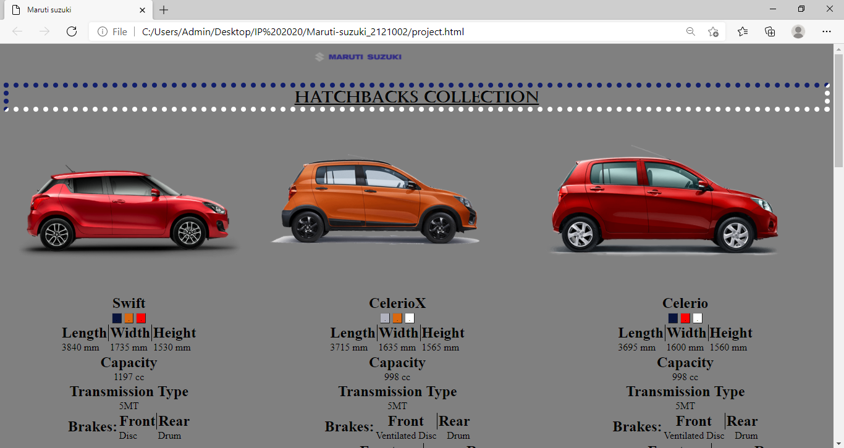
Screenshot

Slide 22
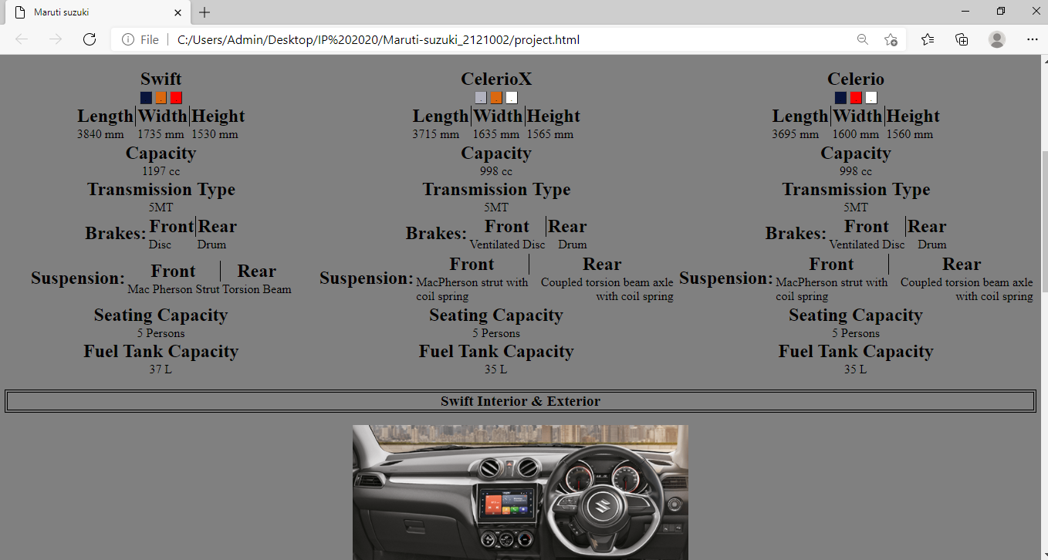

Slide 23
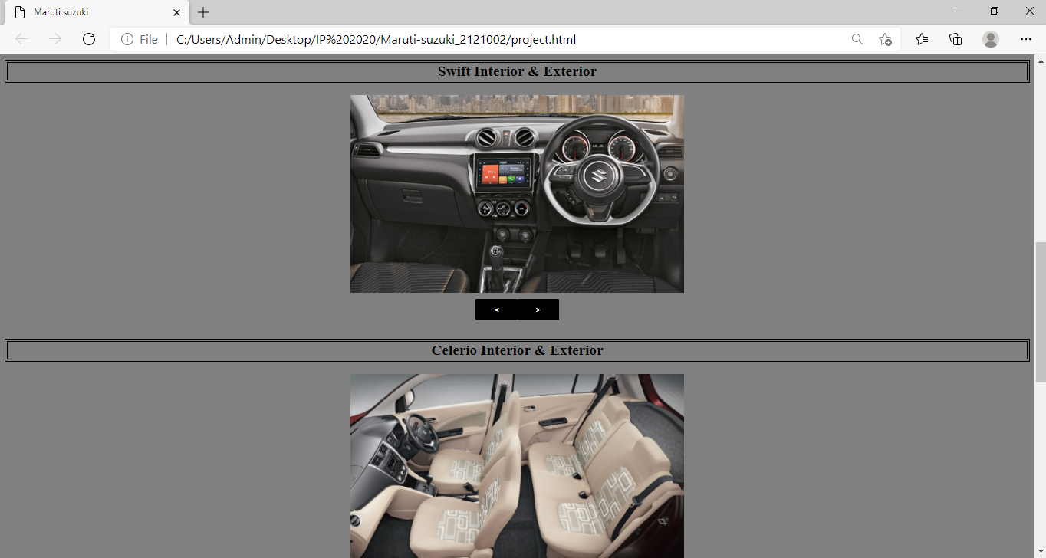

Slide 24
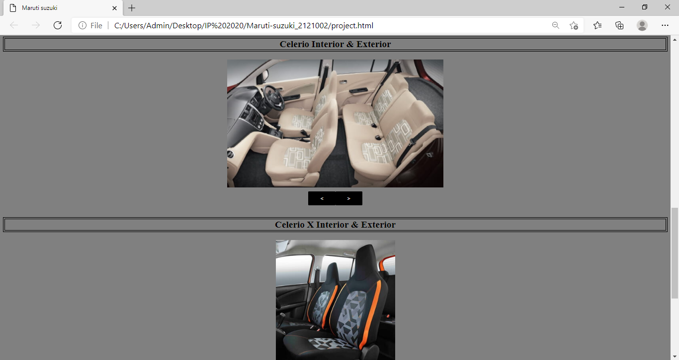

Slide 25
